Slide 1
Air pollution trends in the US.

Slide 2
Air Pollution.
Air pollution refers to the release of pollutants in the air that are harmful to humans and the environment.
Our project focuses on one main pollutant which is Carbon Monoxide. However other harmful pollutants include Nitrogen Oxide, Ozone and Sulfur Dioxide.
We acquired data sets that include the most and least polluted cities in the past few years.

Slide 3
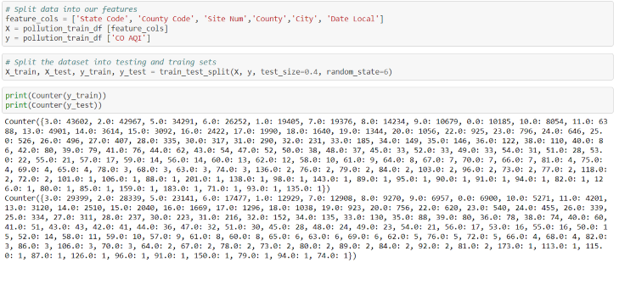
Machine Learning Model
We used jupyter notebook to create our model. After importing the dependencies needed, we used a train split test on our x and y variables.

Slide 4
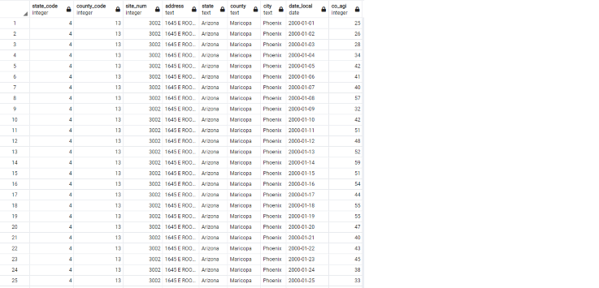
Amazon RDS and PostgresSQL
Using Amazon Web Service RDS, we created a database which we then linked with pgAdmin. We created tables to allow us to view the most and least polluted cities.
Notes:
To display the comparison’s between the two cities, we used an inner join.

Slide 5
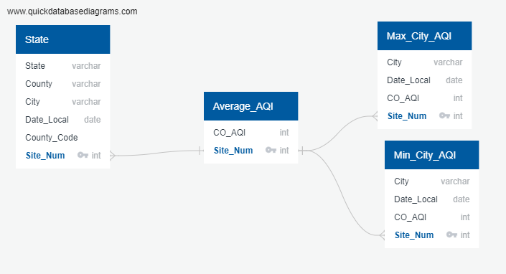
Postgres ERD

Slide 6
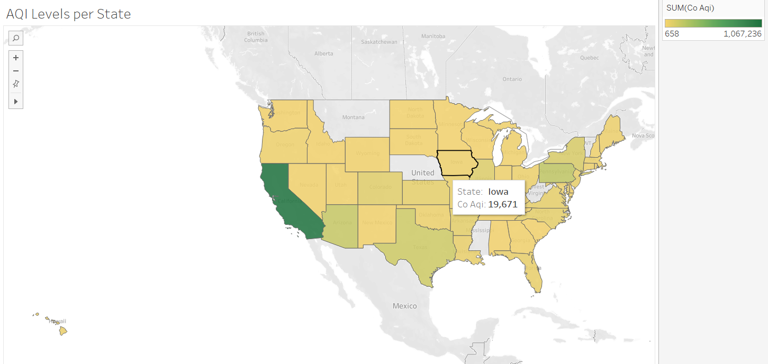
Tableau
As our goal was to provide trends over time, we used Tableau to create data visuals.
Notes:
Below as you can see, pollution is evident in many states. The more populated parts of the country have the most pollution with California taking the lead.

Slide 7
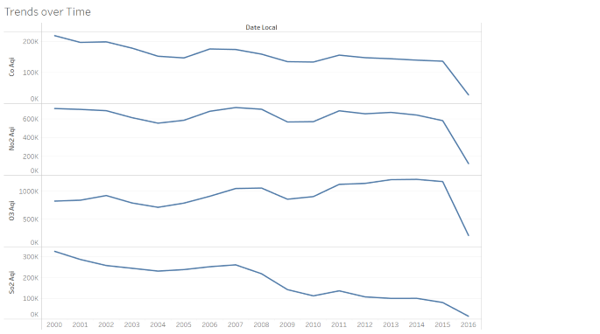
Pollutant Levels over Time
Notes:
Pollution levels have decreased. Probably due to the publics awareness.

